Slide 1
Machine Learning

Slide 2
What is Machine Learning?
Algorithms that can
learn from
and
make predictions
on data.

Slide 3
Types of ML Problems
Regression
Classification
Clustering
Dimensionality Reduction

Slide 4
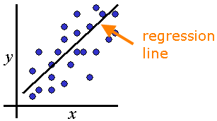
Regression
Predict y given x
Y is dependent variable. X is independent.
There may be multiple independent variables with differing correlations to y
Useful when x and y have a near linear relation
Use linear regression when there is a linear correlation between x and y

Slide 5
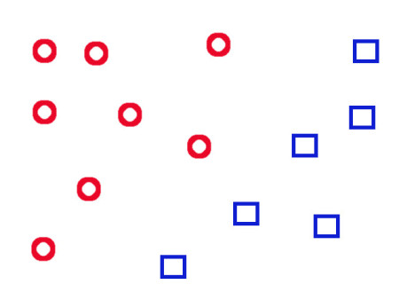
Classification
Z
Circles
How do we classify the new object, Z ?
It’s probably a Circle.
Squares
Identifying which category or sub-population a new instance belongs to
Uses a training set of data containing instances whose category membership is known
Notes:
Given a bunch of known objects (training data set), how do we identify a new object?

Slide 6
Clustering
Z
A new object, Z we guess is in the yellow group because it is closest to that cluster
Grouping data into categories based on some measure of inherent similarity or distance
No training data is given.

Slide 7
Dimensionality Reduction
For very large data sets ML algorithms may be too slow
Performance can be improved by only using those variables with the strongest predictive power (highest correlation)
Rank dimensions by strength; remove weak dimensions
Notes:
Dimensionality reduction saves memory and storage space, and improves performance. The leading dimensionality reduction technique is called Principal Components Analysis (PCA), in which variables are selected based upon highest variance and orthogonality.

Slide 8
Supervised vs. Unsupervised Learning
Supervised
a training set of correctly identified objects is available
Eg. Classification, Regression
Unsupervised
No training data
Eg. Clustering

Slide 9
ML Algorithms
Decision Trees
Support Vector Machines
Random Forests
K Nearest Neighbors
K Means
Naïve Bayes
Neural Networks
Deep Learning
Notes:
This is only a partial list of machine learning techniques and algorithms.

Slide 10
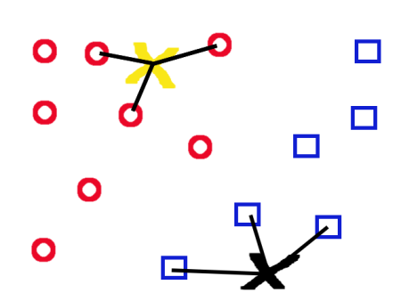
KNN – K Nearest Neighbors
New objects are identified using a vote by their nearest neighbors.
Here K=3, so a new object looks at its 3 nearest neighbors to identify itself. The green X must be a circle.
K can be any number, but is usually odd.
There are many different ways to measure distance
X
Notes:
If, for instance, K=9 then a new object will look at its 9 nearest neighbors and decide its identity based on a (usually weighted, so that nearer neighbors have more say) vote. If 5 neighbors are circles and 4 are squares then the new object is a circle. Useful for classification problems such as character recognition or email spam detection.

Slide 11
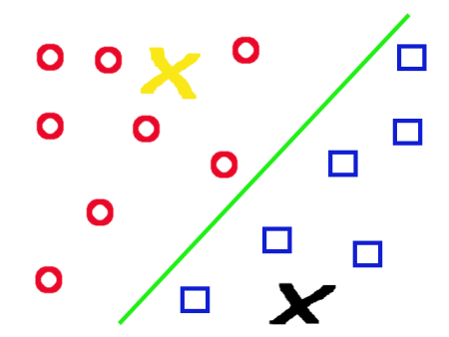
SVM – Support Vector Machines
SVM draws a line between the circles and squares
Any new object above the line is a circle and any new object below it a square
SVM is used for image classification, facial expression classification, etc.

Slide 12
K Means
Clustering algorithm that groups objects into K sets by minimizing the mean distance of a set’s points from its centroid.
centroid
Here K=3, so we see 3 clusters.
New objects are grouped with the nearest cluster (min distance from centroid)

Slide 13






Machine Learning Tools
Cloud
Amazon ML
Google TensorFlow
Google Prediction
Azure ML
Python

